Slide 1


Spark Frameworks and Architecture
25-11-2022
Jai Prakash Verma

Slide 2
Agenda
Big Data
Big Data Analytics: Open Source Solutions
Introdution: Spark
Spark Vs MapReduce
Spark Essentials
Spark Architecture
Spark Components
Advanced Spark Programming
25-11-2022

Slide 3
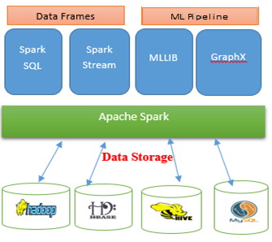
Spark Architecture

Slide 4
Spark Components
Apache Spark Core
Spark SQL
Spark Streaming
MLlib (Machine Learning Library)
GraphX
25-11-2022

Slide 5
Apache Spark Core
Spark Core is the underlying general execution engine for spark platform that all other functionality is built upon. It provides In-Memory computing and referencing datasets in external storage systems.
25-11-2022

Slide 6
Spark SQL
Spark SQL is a component on top of Spark Core that introduces a new data abstraction called SchemaRDD, which provides support for structured and semi-structured data.
Blurs the lines between RDDs and relational tables.
Intermix SQL commands to query external data, along with complex analytics, in a single app:
  Allows SQL extentions based on Mllib
  Shark is being migrated to SparkSQL
  Demo
25-11-2022

Slide 7
SparkSQL Continue...
from pyspark.sql import SQLContext
from pyspark import SparkContext
sc = SparkContext()
sqlCtx = SQLContext(sc)
# Load a text file and convert each line to a dictionary!
lines = sc.textFile("hdfs://localhost:9000/user/people.txt")
parts = lines.map(lambda l: l.split(","))
people = parts.map(lambda p: {"name": p[0], "age": int(p[1])})
# Infer the schema, and register the SchemaRDD as a table.!
# In future versions of PySpark we would like to add support !
# for registering RDDs with other datatypes as tables!
peopleTable = sqlCtx.inferSchema(people)
peopleTable.registerAsTable("people")
# SQL can be run over SchemaRDDs that have been registered as a table!
teenagers = sqlCtx.sql("SELECT name FROM people WHERE age >= 13 AND age <= 19")
teenNames = teenagers.map(lambda p: "Name: " + p.name)
teenNames.collect()
teenNames.saveAsTextFile("hdfs://localhost:8020/user/output7")
25-11-2022

Slide 8
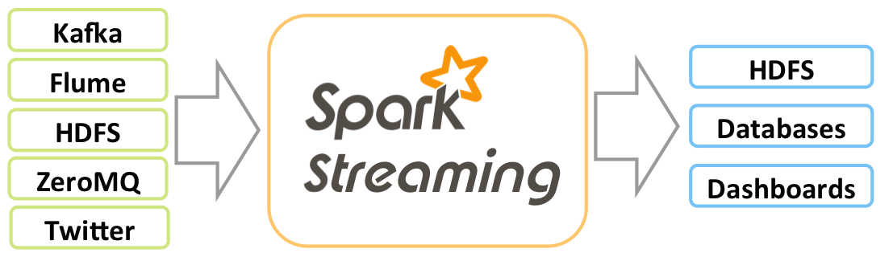
Spark Streaming
Spark Streaming leverages Spark Core's fast scheduling capability to perform streaming analytics. It ingests data in mini-batches and performs RDD (Resilient Distributed Datasets) transformations on those mini-batches of data.
Spark Streaming extends the core API to allow high-throughput, fault-tolerant stream processing of live data streams
25-11-2022

Slide 9
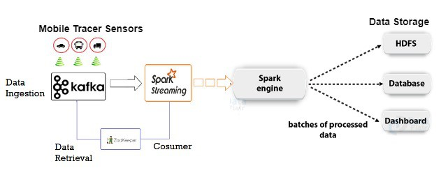
Spark Streaming- Use Case
25-11-2022

Slide 10
Example- Spark Streaming
Start Zookeeper :- Since zookeepr is a long-running service, you should run it in its own terminal
  sudo zookeeper-server-start /etc/kafka/zookeeper.properties
Start Kafka :- also in its own termin
  sudo kafka-server-start /etc/kafka/server.properties
Start producer :- use a new terminal
  kafka-console-producer --broker-list localhost:9092 --topic test
Start Kafka Consumer :- in a new terminal
  kafka-console-consumer --zookeeper localhost:2181 --topic test --from-beginning
For Spar Streaming:
  spark-submit --jars spark-streaming-kafka-assembly_2.10-1.6.0.jar kafkawordcount.py localhost:2181 test
  Source: https://datasciencenovice.wordpress.com/2016/07/04/installing-kafka-spark-on-ubuntu-14-04-16-04-lts/
25-11-2022

Slide 11
MLlib (Machine Learning Library)
MLlib is a distributed machine learning framework above Spark because of the distributed memory-based Spark architecture.
Spark MLlib is nine times as fast as the Hadoop disk-based version of Apache Mahout (before Mahout gained a Spark interface).
25-11-2022

Slide 12
Machine Learning Algorithm - MLlib
MLlib is Spark’s machine learning (ML) library.
Its goal is to make practical machine learning scalable and easy.
It consists of common learning algorithms and utilities, including classification, regression, clustering, collaborative filtering, dimensionality reduction, as well as lower-level optimization primitives and higher-level pipeline APIs.
Demo : MLlib Algorithm
Source:http://spark.apache.org/docs/latest/mllib-guide.html

Slide 13
Example - MLLib
Clustering:
  spark-submit kmean_test_center.py kdata.txt 3
Classification
  spark-submit multilayer_perceptron_classification.py
Frequent Itemset
  spark-submit FPGrowth.py
25-11-2022

Slide 14
GraphX
GraphX is a distributed graph-processing framework on top of Spark. It provides an API for expressing graph computation that can model the user-defined graphs by using Pregel abstraction API. It also provides an optimized runtime for this abstraction.
25-11-2022

Slide 15
GraphFrame
GraphFrames is an API for doing Graph Analytics on Spark DataFrames.
This way, we can try to recreate SQL queries in Graphs and have a better grasp of the graph concepts.
25-11-2022

Slide 16
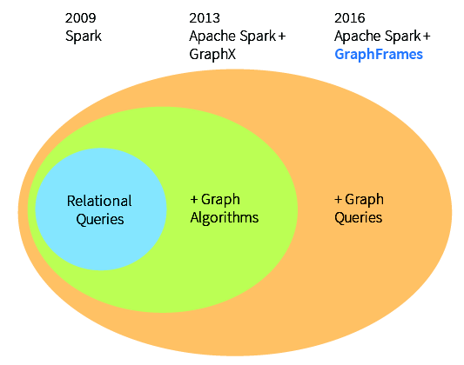
GraphFrames
25-11-2022

Slide 17
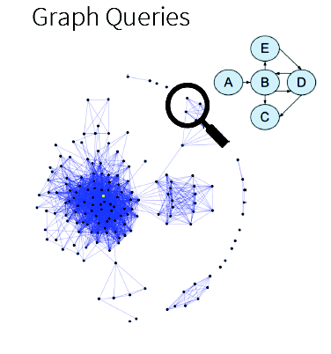
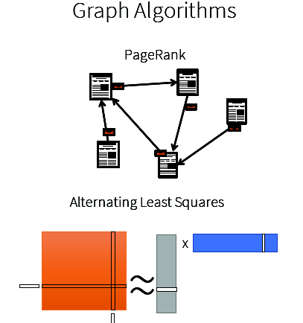
Graph Algorithm vs Graph Queries
25-11-2022

Slide 18
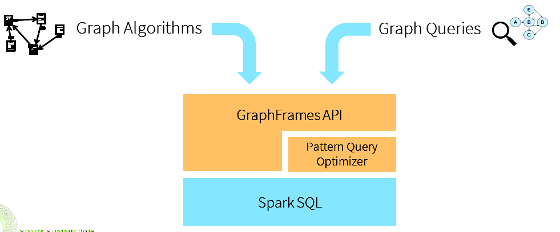
GraphFrames
25-11-2022

Slide 19
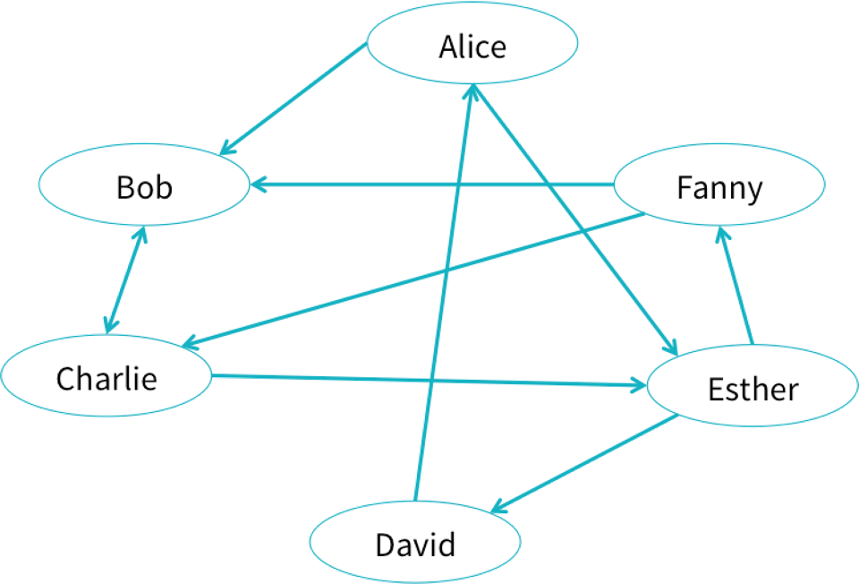
An example social network
25-11-2022

Slide 20
Demo Graph Analytics
Using GraphFrames with pyspark
pyspark --packages graphframes:graphframes:0.1.0-spark1.6
  import graphframes
  from graphframes import *
25-11-2022

Slide 21
BI Questions
Which users are most influential?
Users A and B do not know each other, but should they be introduced?
25-11-2022

Slide 22
Creating GraphFrames
Vertex DataFrame
Edge DataFrame
25-11-2022

Slide 23
Create a Vertex DataFrame with unique ID column "id"
v = sqlContext.createDataFrame([
("a", "Alice", 34),
("b", "Bob", 36),
("c", "Charlie", 30),
("d", "David", 29),
("e", "Esther", 32),
("f", "Fanny", 36),
("g", "Gabby", 60) ], ["id", "name", "age"])
25-11-2022

Slide 24
Create an Edge DataFrame with "src" and "dst" columns
  e = sqlContext.createDataFrame([
  ("a", "b", "friend"),
  ("b", "c", "follow"),
  ("c", "b", "follow"),
  ("f", "c", "follow"),
  ("e", "f", "follow"),
  ("e", "d", "friend"),
  ("d", "a", "friend"),
  ("a", "e", "friend")
  ], ["src", "dst", "relationship"])
25-11-2022

Slide 25
Graph Analytics (Continue...)
Create a GraphFrame
  g = GraphFrame(v, e)
Query: Get in-degree of each vertex.
  g.inDegrees.show()
Query: Count the number of "follow" connections in the graph.
  g.edges.filter("relationship = 'follow'").count()
Run PageRank algorithm, and show results.
  results = g.pageRank(resetProbability=0.01, maxIter=20)
  results.vertices.select("id", "pagerank").show()
25-11-2022

Slide 26
Graph Analytics (Continue...)
How many users in our social network have “age” > 35?
  g.vertices.filter("age > 35").show()
How many users have at least 2 followers?
  g.inDegrees.filter("inDegree >= 2").show()
25-11-2022

Slide 27
Graph algorithms support complex workflows
what are the most important users?
  results = g.pageRank(resetProbability=0.15, maxIter=10)
  results.vertices.show()
25-11-2022

Slide 28
GraphX algorithms supported by GraphFrames
PageRank: Identify important vertices in a graph
Shortest paths: Find shortest paths from each vertex to landmark vertices
Connected components: Group vertices into connected subgraphs
Strongly connected components: Soft version of connected components
Triangle count: Count the number of triangles each vertex is part of
Label Propagation Algorithm (LPA): Detect communities in a graph
25-11-2022

Slide 29
Spark Programming
Spark contains two different types of shared variables − one is broadcast variables and second is accumulators.
  Broadcast variables − used to efficiently, distribute large values.
  Accumulators − used to aggregate the information of particular collection.
25-11-2022

Slide 30
Broadcast Variables
Broadcast variables let programmer keep a read only variable cached on each machine rather than shipping a copy of it with task.
For example, to give every node a copy of a large input dataset efficiently
Spark also attempts to distribute broadcast variables using efficient broadcast algorithms to reduce communication cost.
25-11-2022

Slide 31
Broadcast Variables continue....
>>> broadcastVar = sc.broadcast(list(range(1, 4)))
16/11/18 21:57:43 INFO storage.MemoryStore: Block broadcast_0 stored as values in memory (estimated size 296.0 B, free 296.0 B)
16/11/18 21:57:43 INFO storage.MemoryStore: Block broadcast_0_piece0 stored as bytes in memory (estimated size 101.0 B, free 397.0 B)
16/11/18 21:57:43 INFO storage.BlockManagerInfo: Added broadcast_0_piece0 in memory on localhost:44951 (size: 101.0 B, free: 511.1 MB)
16/11/18 21:57:43 INFO spark.SparkContext: Created broadcast 0 from broadcast at PythonRDD.scala:430
>>> broadcastVar.value
[1, 2, 3]
>>>
25-11-2022

Slide 32
Accumulators
Accumulators are variables that can only be “added” to through an associative operations.
Used to implement counters and sums, efficiently in parallel
Spark nativily supports accumulators of numeric value types and standard mutable collections, and programmers can extend of new types
Only the driver program can read an accumulator's value, not the task.
25-11-2022

Slide 33
Accumulators continue....
accum = sc.accumulator(0)
rdd = sc.parallelize([1, 2, 3, 4])
def f(x):
global accum
accum += x
rdd.foreach(f)
accum.value
25-11-2022

Slide 34
Spark - Installation
For Spark Installation with Hadoop:
  http://hadooptutorials.co.in/tutorials/spark/install-apache-spark-on-ubuntu.html
For Spark Web Console:
  http://localhost:4040
For Spark Tutorial:
  https://www.tutorialspoint.com/apache_spark/apache_spark_quick_guide.htm
25-11-2022

Slide 35
Questions
Jaiprakash.verma@nirmauni.ac.in
9427621081
25-11-2022

